Slide 1
Prime location in Lucknow, India for Real Estate investments
Dheerendra Kumar Singh

Slide 2
Table of Contents
Introduction
Business Problem
Audience
Data Section
Methodology
Analysis
Results and Discussion
Conclusion

Slide 3
Introduction
A Real Estate investor Mr. XYZ from Mumbai, India has decided to expand his business in other parts of country. His business is to Buy, Renovate and Sell Real Estate properties. He decided to expand his business in Lucknow, the capital of UP, India. Since this is a new location for him, he decided to take help from professional data scientist to explore the prime location for Real Estate Investment in Lucknow.

Slide 4
Business Problem
The task is to locate the hotspot for Real Estate investment in Lucknow, India. Selection of location should be based on its nearby venues.

Slide 5
Audience
Mr. XYZ from Mumbai, India is stakeholder who want to expand his business to new place. Before investing, Mr. XYZ want to explore the neighborhood and would be sure that his investment is profitable.

Slide 6
Data Section
1. Postal code data with coordinates
Source: IN.zip file from http://www.geonames.org/export/zip/
2. FourSquare API to explore the location
3. Folium API to visualize result on map
4. Data collection for different Blogs and Real Estate Websites

Slide 7
Methodology
Homes that are closer to the School, Hospital, Restaurant, Clubs, Gym, Airport, Bus transport, etc are sell at a higher price and having more demand than others. The majority of people want to live close to where they work, shop and go out to enjoy themselves.
So, we will explore the neighborhood by is nearby venues. For the same purpose, We will use FourSquare API to explore the venues for each neighborhood.

Slide 8
Analysis
Load data from IN.txt file.
Did some web search and identified some location for Real Estate investment. Sample list as below
In order to explore nearby venues of neighborhood, we used FourSquare API.
We combined the data from all point of interest and removed the duplicate records, if any.
After cleaning data, we group it to identify 3 most promising location for real estate investment.
The top three location are as below

Slide 9
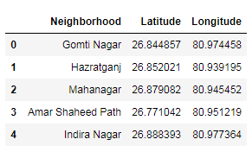
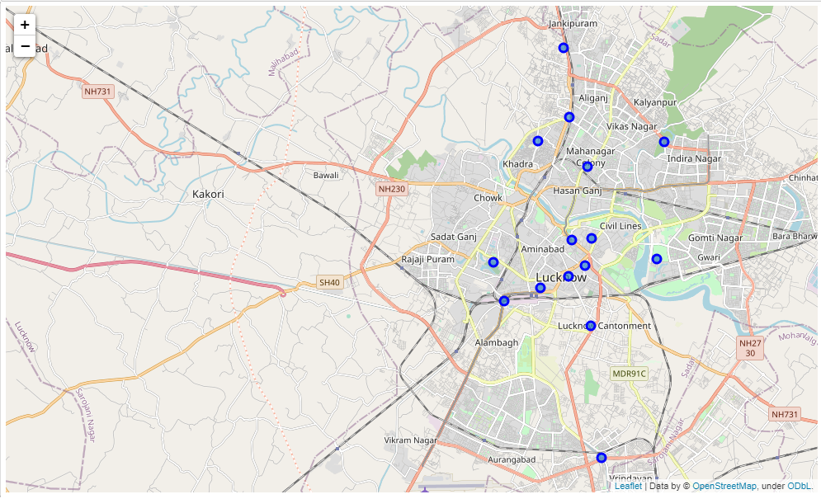
Hotspot for Real Estate in Lucknow

Slide 10
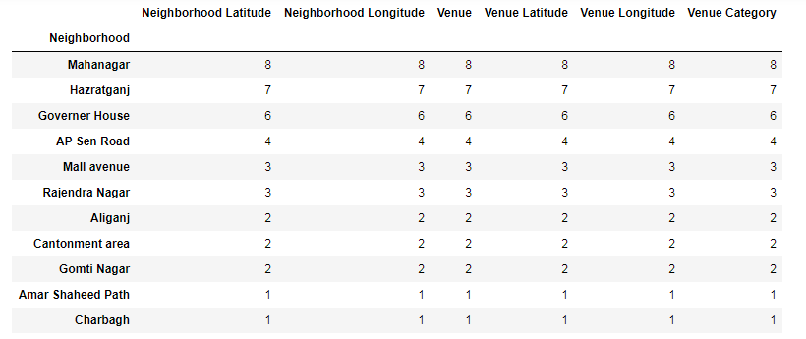
Top three location for investment

Slide 11
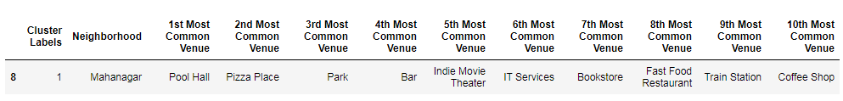
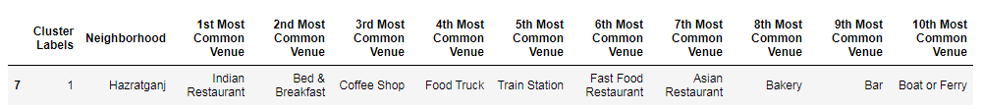
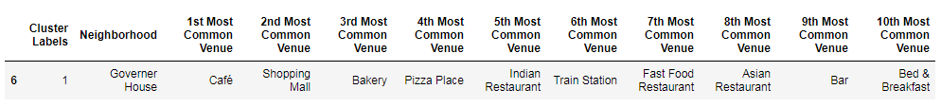
Top 10 venues nearby for each location

Slide 12
Results and Discussion
In this study, I have analyzed different location of Lucknow city based on nearby venues. Based on analysis, we have identified top three neighborhood for real estate investment. They are as follows:
Mahanagar
Hazratganj
Governer House
As expected, the data was not available in ready-to-use form. I gathered data from different plateforms like web search, Real Estate web portals, newspaper, and enquiry from various peoples, etc.

Slide 13
Conclusion
Mr. XYZ should invest in below there location to maximize his profit.
Mahanagar
Hazratganj
Governer House

Slide 14
Thank you

